Slide 1


SQL Project: RCB - IPL Strategy
Submitted By:
VIVEK KUMAR YADAV

Slide 2

Problem Statement
You are hired as a sport data analyst by RCB where the team is looking for top-performing and reliable players to win tournaments, considering both on-field performance and value for money in mega player auction of 2017.
Your task is to come up with strategies/suggestions regarding selecting the best-performing players and optimizing player auction investments.
Objective
To analyze IPL player performance data and identify the most reliable, high-impact players for RCB. The goal is to build a competitive, well-balanced squad while maximizing value in the mega auction.

Slide 3
Data Description
Ball_by_Ball
Match_id: Unique identifier for a cricket match
Over_id: Unique identifier for an over in a cricket match
Ball_id: Unique identifier for a ball in an over
Innings_No: The innings number in a cricket match
Team_Batting: The team batting in a particular innings
Team_Bowling: The team bowling in a particular innings
Striker_Batting_Position: The batting position of the striker batsman
Striker: The batsman currently on strike
Non_Striker: The batsman currently at the non-striker's end
Bowler: The bowler bowling the current delivery
Batting_style
Batting_id: Unique identifier for a batsman's batting record
Batting_hand: The batting hand (right or left) of a batsman
Bowling_style
Bowling_id: Unique identifier for a bowler's bowling record
Bowling_skill: The bowling skill (e.g., right-arm fast, left-arm spin) of a bowler
City
City_id: Unique identifier for a city
City_Name: The name of a city
Country_id: Unique identifier for a country

Slide 4
Data Description
Extra Type
Extra_Type_Id: Unique identifier for the type of extra runs scored in a cricket match.
Extra_Runs: The number of extra runs scored in a particular delivery.
Innings_No: The innings number in a cricket match.
Extra_Id: Unique identifier for an instance of extra runs scored.
Extra_Name: The name or description of the type of extra runs scored (e.g., byes, leg byes, wides, no-balls).
Season
Season_Id: Unique identifier for a particular season or tournament.
Venue_Id: Unique identifier for the venue or stadium where the match is played.
Win_By
Win_Type: The type of win (e.g., runs, wickets) achieved by the winning team.
Win_Margin: The margin of victory (e.g., runs or wickets) for the winning team.
Outcome
Outcome_type: The type of outcome or result of the match (e.g., win, loss, tie, no result).
Match_Winner: The team that won the match.
Man_of_the_Match: The player awarded the Man of the Match award.
Out_Type
Out_Id: Unique identifier for the type of dismissal or way a batsman got out.
Out_Name: The name or description of the type of dismissal (e.g., caught, bowled, lbw, run out).
Outcome_Id: Unique identifier for the outcome or result of a match.

Slide 5
Data Description
Rolee
Role_Id: Unique identifier for a player's role or skills (e.g., batsman, bowler, all-rounder).
Role_Desc: Description of a player's role or skills.
Man_of_the_Series: The player awarded the Man of the Series award for a particular tournament.
Orange_cap: The player awarded the Orange Cap (for most runs scored) in a particular tournament.
Purple_cap: The player awarded the Purple Cap (for most wickets taken) in a particular tournament.
Team
Team_Id: Unique identifier for a team.
Team_Name: The name of a team.
Umpire
Umpire_id: Unique identifier for an umpire officiating the match.
Umpire_name: The name of an umpire.
Umpire_country: The country or nationality of an umpire.
Toss Decision
Toss_Name: The name or description of the toss (e.g., heads or tails).
Player
Player_Id: Unique identifier for a player.
Player_Name: The name of a player.
Extra Runs
Ball_Id: Reference to the specific ball during which extra runs were conceded.
Extra_Type_Id: Type of extra run (e.g., wide, no-ball).
Innings_No: The innings number during which the extra run occurred.
Match_Id: Reference to the match in which the extra runs were conceded.

Slide 6
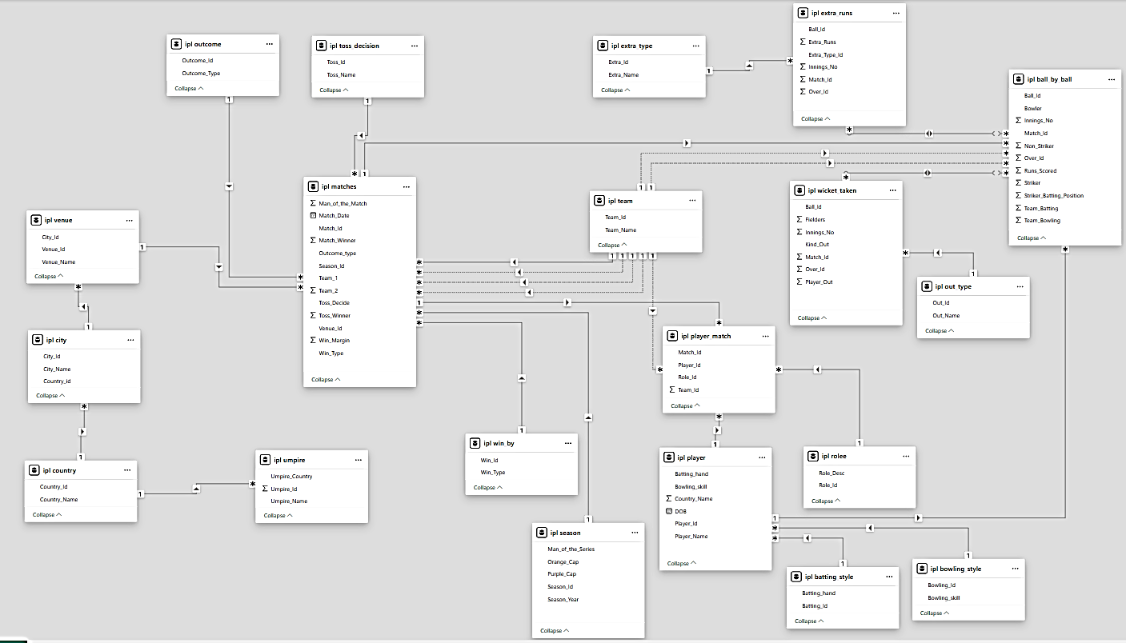
Database Schema

Slide 7
Data Overview & Methodology
Data Sources
Match Data
Season, venue, teams, toss details, match outcomes
Ball-by-Ball Data
Every delivery: bowler, batsman, runs, wickets, extras
Data Sources
Player Data
Demographics, bowling styles, batting positions
Venue Data
Stadium details, geographical factors, pitch characteristics
Analysis Methodology
SQL-Powered Analysis
Sophisticated SQL queries extracted patterns across seasons, teams, venues:
Player performance metrics and rankings Team win-loss patterns with venue correlations Match factor analysis (toss, batting order) Player consistency tracking across seasons

Slide 8
Strategic Takeaways
Batting Champions & Strike Rates
Bowling Stars & Economy Rates
Toss Decision Impact
Win-Loss Patterns & Venue Impact
Team Insights: RCB Performance Analysis
All-rounders & Consistent Performers
Strategic KPIs for Team Success
Data-driven Player Recommendations
Key Findings & Conclusion

Slide 9


Batting Champions & Strike Rates
Highlighting IPL's top performers by batting average and strike rate
Top Batting Averages
Batting Champions – Average Runs per Innings:
This analysis evaluates RCB batsmen based on their average runs per innings across all IPL seasons. It helps identify consistent performers who could be valuable assets in future auctions. Players with higher averages demonstrate reliability and the potential to anchor innings, making them strong contenders for retention or strategic bidding.
LMP Simmons
22 Innings, 942 Runs
42.82
V Kohli
63 Innings, 2472 Runs
39.24
DA Warner
62 Innings, 2348 Runs
37.87
N Rana
3 Innings, 104 Runs
34.67
MEK Hussey
30 Innings, 1019 Runs
33.97
Batting Average = Total Runs / Innings Played

Slide 10
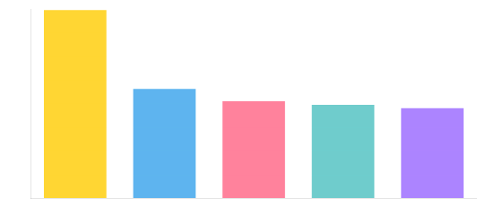
Batting Champions & Strike Rates
Highlighting IPL's top performers by batting average and strike rate
Top Strike Rates
Top Strike Rates :
This query identifies the Top players with the highest strike rates over the seasons, measuring how quickly players score runs. High strike rate batsmen are valuable in T20 formats for accelerating innings. For RCB, such players could be prioritized for aggressive middle-order roles or targeted in the upcoming auction.
RV Gomez
Limited Balls Faced
400.00
AN Ahmed
Impact Player
233.33
CR Brathwaite
Big-hitting All-rounder
207.50
PJ Sangwan
Tailender Hitter
200.00
Bipul Sharma
Lower-order Explosive
192.59
Strike Rate = (Runs Scored / Balls Faced) × 100

Slide 11

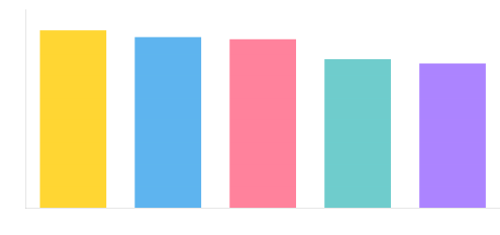
Bowling Stars
Showcasing IPL's wicket-takers and their bowling performance metrics
Top Wicket Takers
Top Wicket-Takers by Season:
This query identifies the highest wicket-takers across each IPL season by aggregating total dismissals per bowler. It highlights bowlers with consistent match-winning impact. For RCB, such insights are crucial in evaluating past performers and targeting top wicket-takers for strengthening the bowling unit in upcoming auctions.
DJ Bravo
49 Innings, T20 Specialist
81
MM Sharma
Medium-fast Bowler
78
B Kumar
Swing Specialist
77
SL Malinga
42 Innings, Yorker Expert
66
SP Narine
Mystery Spinner
68
Total Wickets = Sum of all wickets taken across seasons

Slide 12
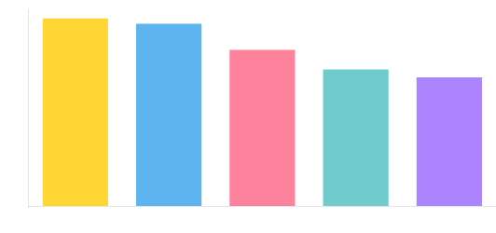
Bowling Stars
Showcasing IPL's wicket-takers and their bowling performance metrics
Top Bowling Averages
Bowling Performance
This query tracks the total number of wickets taken by each bowler per season. It helps evaluate a player's consistency and impact across different IPL years. For RCB, analyzing seasonal wicket trends supports decisions on retaining effective bowlers or scouting potential replacements for future auctions.
A Zampa
Leg-spin, 12 wickets in 5 innings
2.40
Kuldeep Yadav
7 wickets in 3 innings
2.33
R McLaren
4 wickets in 2 innings
2.00
Harmeet Singh
7 wickets in 4 innings
1.75
DJ Bravo
81 wickets in 49 innings
1.65
Bowling Average = Total Wickets / Innings Bowled

Slide 13
Toss Decision Impact
How winning the toss and choosing to bat or field affects match outcomes by venue
Key Venues & Winning Decisions
Brabourne Stadium
Bat First:
100%
Field First:
33.33%
Batting first strongly preferred
Sheikh Zayed Stadium
Bat First:
75%
Field First:
66.67%
Slight advantage to batting
Sawai Mansingh Stadium
Bat First:
75%
Field First:
25%
Toss Impact – Venue-wise Win Percentage Based on Toss Decisions
This query analyzes how toss decisions (bat or field first) influence match outcomes across different venues. It calculates the percentage of matches won by teams that won the toss. These insights help RCB optimize match-day strategies based on venue-specific trends and inform decisions during high-pressure toss moments.
Fielding first advantageous
Punjab Cricket Association Stadium
Bat First:
50%
Field First:
54.55%
Slight advantage to fielding

Slide 14
Win-Loss Pattern & Venue Impact
How venues affect team performance and run totals across IPL seasons
RCB’s Win-Loss Pattern Venue Performance
M Chinnaswamy
16 W / 11 L
Uppal
1 W / 3 L
Maharashtra
2 W / 0 L
Eden Garden
2W / 0 L
Kotla
2 W / 0 L
Other
1 W / 1 L
RCB Venue Performance – Wins and Losses by Stadium:
This analysis evaluates RCB’s performance at different IPL venues by comparing total wins and losses. RCB has shown strong dominance at their home ground, M. Chinnaswamy Stadium (16 wins, 11 losses), while maintaining a 100% win record at Feroz Shah Kotla and Maharashtra Cricket Association Stadium. However, venues like Rajiv Gandhi International Stadium and Wankhede Stadium have posed challenges, with more losses than wins. These insights can help RCB prioritize strategy and player selection based on venue-specific trends in future seasons and auctions.

Slide 15
Team Insights: RCB Performance Analysis
Analyzing Royal Challengers Bangalore's journey, performance trends, and strategic challenges
Season | Total Matches | Matches Won | Win %
2013 | 16 | 1 | 6.25
2014 | 14 | 1 | 7.14
2015 | 16 | 3 | 18.75
2016 | 16 | 0 | 0
RCB's Seasonal Performance Overview (2013–2016):
This analysis tracks RCB’s win percentage across IPL seasons from 2013 to 2016. The data reveals consistently poor performance, with the highest win rate at just 18.75% in 2015 (3 wins in 16 matches) and no wins in 2016. Such underwhelming outcomes highlight the need for major strategic overhauls—particularly in team selection and leadership—when preparing for future auctions and squad rebuilding.

Slide 16
All – Rounder & Consistent Performers
Player Name | Total Runs | Total Wickets
Identifying IPL's dual-impact players and season-after-season performers
DR Smith | 1707 | 81
KA Pollard | 1320 | 67
SR Watson | 1315 | 61
RA Jadeja | 670 | 56
MC Henriques | 643 | 54
STR Binny | 553 | 48
AD Russell | 527 | 46
JH Kallis | 462 | 41
JP Faulkner | 459 | 37
DJ Bravo | 423 | 35
NLTC Perera | 397 | 32
AR Patel | 379 | 30
Shakib Al Hasan | 379 | 25
Harbhajan Singh | 353 | 23
CH Morris | 285 | 20
KV Sharma | 267 | 19
IK Pathan | 219 | 17
Azhar Mahmood | 202 | 17
R Bhatia | 200 | 15
Top All-Rounders – Dual Impact Players
This query identifies top all-rounders who have scored 200+ runs and taken 15+ wickets across all IPL seasons. These players bring dual value with both bat and ball, making them highly strategic assets. For RCB’s auction planning, such multi-skilled performers are ideal to balance the squad and enhance flexibility in team composition.

Slide 17


Strategic KPIs for Team Success
Key Performance Indicators that drive strategic decisions and team performance
Performance Metrics
1. Win Percentage
Measures overall success rate across seasons
(Matches Won / Matches Played) × 100
Team Success
RCB home win rate: 55.17% at M Chinnaswamy
4. Run Rate
Measures scoring speed across matches
Total Runs Scored / Total Overs Faced
Scoring Speed
2. Average Runs per Match
Measures team's scoring consistency
Total Runs Scored / Total Matches Played
Batting
Top team: Kings XI Punjab (2014): 176.5 runs/match
5. Toss Impact KPI
Win % after toss decision (bat/field)
(Wins After Decision / Matches with That Decision) × 100
Strategy
3. Average Wickets per Match
Shows bowling strength of team
Total Wickets Taken / Total Matches Played
Bowling
MA Chidambaram: 72.73% wins when batting first
Barabati Stadium: 66.67% wins when fielding first
Chennai Super Kings (2015): 7.06 wickets/match
Translating KPIs into Winning Strategies: RCB has demonstrated strong batting capabilities with a high run rate and powerful top-order performances. By strengthening bowling depth, reinforcing the middle order, and optimizing toss-time decisions, the team can convert its potential into consistent victories. These KPIs offer a clear roadmap to build a more balanced and competitive squad for future success.

Slide 18

Data-driven Player Recommendations
Player selection based on performance metrics, consistency, and venue expertise
High Impact Players (Highest Total in all Seasons)
Top 5 High Impact Players
Player Name | Total Runs (all Seasons)
Virat Kohli | 2472
DA Warner | 2348
AB de Villiers | 1968
RG Sharma | 1899
RV Uthappa | 1852
Player-wise Seasonal Batting Trends:
The season-wise batting performance highlights Virat Kohli as the top run-scorer with 2,472 runs, showcasing exceptional consistency across multiple seasons. Close behind, David Warner (2,348 runs) and AB de Villiers (1,968 runs) also demonstrated strong, reliable form. Rohit Sharma and Robin Uthappa, each crossing 1,800 runs, underline their value as experienced contributors. These trends not only spotlight key performers but also help identify stable batting pillars for future team planning and auction strategies.

Slide 19
Data-driven Player Recommendations
Player selection based on performance metrics, consistency, and venue expertise
High Impact Players (Highest Wickets in all Seasons)
Top 5 High Impact Players
Player Name | Total Wickets (all Seasons)
DJ Bravo | 81
MM Sharma | 78
B Kumar | 77
SP Narine | 68
Harbhajan Singh | 67
Bowling Performance Insights Across Seasons:
The multi-season wicket trends reveal Dwayne Bravo as the most impactful bowler with 81 wickets, consistently performing across all four seasons. Mohit Sharma (78) and Bhuvneshwar Kumar (77) follow closely, showing strong year-on-year contributions. Sunil Narine and Harbhajan Singh, with 68 and 67 wickets respectively, demonstrate their long-term effectiveness. The visual progression highlights players like Bravo and Kumar sustaining peak form, making them critical bowling assets for any team’s strategy.

Slide 20
Data-driven Player Recommendations
Player selection based on performance metrics, consistency, and venue expertise
RCB players with High Average Runs
Consistent Run-Scorers and Key Contributors:
Virat Kohli leads the batting performance with a remarkable average of 39.87 runs per match, highlighting his reliability as RCB's most consistent run-scorer. AB de Villiers (34.53) and Chris Gayle (33.35) follow closely, reinforcing their impact in the top order. KL Rahul (29.79) and Yuvraj Singh (26.86) also contribute significantly. This trend underscores a strong core of performers, while players like Takawale and Mandeep Singh add moderate value. These averages provide clear guidance for identifying dependable batting options and evaluating player potential for future match strategies.

Slide 21
Data-driven Player Recommendations
Player selection based on performance metrics, consistency, and venue expertise
New All-Rounders Players for Future Auction
Auction Insight: Top All-Rounders to Target
Pick new players who are good in both batting and bowling for Future Auction
Player Name | Total Runs | Total Wickets
DR Smith | 1707 | 15
KA Pollard | 1320 | 19
SR Watson | 1315 | 54
Yuvraj Singh | 1098 | 13
JP Duminy | 1015 | 13
RA Jadeja | 670 | 56
MC Henriques | 643 | 37
STR Binny | 553 | 20
AD Russell | 527 | 35
JH Kallis | 462 | 23
All-rounders are vital for creating depth in both batting and bowling departments, and this data highlights the top performers who offer dual value. DR Smith stands out with an impressive 1707 runs and 15 wickets, making him a dynamic asset.
SR Watson blends power and control with 1315 runs and a leading 54 wickets, while KA Pollard (1320 runs, 19 wickets) continues to be a dependable finisher and handy bowler. Impact players like RA Jadeja (670 runs, 56 wickets) and AD Russell (527 runs, 35 wickets) provide high-impact contributions in key moments.
These all-rounders bring balance to the squad and are prime candidates for strategic picks in the auction.

Slide 22
Key Findings & Conclusion
Key Data Insights
Top Performer Highlights V. Kohli (39.87 avg), AB de Villiers, and DJ Bravo (81 wickets) stood out as consistent match-winners.
All-Rounder Impact Identified Players like SR Watson (1315 runs, 54 wickets) and RA Jadeja (670 runs, 56 wickets) offer immense auction value.
Venue-Specific Trends Matter RCB excels at M. Chinnaswamy (55.17%-win rate), but struggles at venues like Wankhede and Uppal.
Toss Decisions Drive Outcomes Toss advantage evident at MA Chidambaram (72.73% win when batting first) – a key strategy factor.
Future-Ready Strategy Recommendations
Prioritize All-Rounders in Auctions Build a balanced squad with flexible options across departments.
Strengthen Bowling Attack Focus on death-overs and spin talent to reduce run leakage and boost wicket-taking consistency.
Adopt Venue-Based Squad Rotation Tailor lineups to pitch and performance history across stadiums.
Enhance Tactical Decisions Using Data Leverage win percentage, match-ups, and toss analysis to optimize on-field choices.
Integrate Advanced Analytics in Planning Prepare for real-time strategy tools, predictive modeling, and opposition-based planning as outlined in the roadmap.

Slide 23
Thank You

